Slide 1

IT Products & Product Management
2
+
2
+
Types of project methodology

Slide 2


B.A involvement across the full software development lifecycle
2
+
2
+
Agile Environment

Slide 3
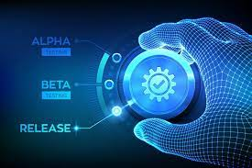
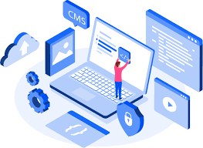
What is sdlc
2
+
Software development life cycle also known as (SDLC) is the process that produces the software with the highest quality and lowest cost. It is a detailed plan for how to develop, alter, maintain, and replace the software. That is take for example Cecure intelligence limited (CIL) is planning to develop or upgrade a software for a client, the process / framework defining the task carried out at each step is what is called (SDLC)

Slide 4


Relevance of a business analyst in sdlc
2
+
An Analogy
Assuming you come to a Restaurant and met me as a waiter ready to take your orders and the below conversation takes place.
Customer: Do you have Pounded yam + Egusi
Waiter: I don’t have idea if Egusi is available
Customer: How long does it take for Egusi to be ready if is not ready and are they are still going to make it for the day
Waiter: I am not sure of how long it takes for it to be ready or if it will be prepared for the day.
Customer: What other Soup do you have available?
Waiter: I am not sure if we still have vegetables or draw soup.
In this analogy, even though the waiter is not part of the kitchen team, the customer doesn’t expect to get a concise response but s/he expects to get more than a vague response. When compared to SDLC the kitchen team can be referred to as the development team while the waiter the business analyst. The business analyst is expected to be the liaison personnel between the customer and developers. He would be able to understand & communicate the business requirement of the customer and translate it to the technical requirement which the software development team understand.

Slide 5

Business Analyst
Responsibilities in SDLC
Agile Scrum Stages
Considering that I am working in an agile environment for the software development life cycle (SDLC), my main focus is to understand the different stages of agile in SDLC and with that I can know what next to do at each stage.
There are 5 stages in the Agile Environment.
1) Inception / Planning stage
2) Analysis/ Elaboration Stage
3) Design Stage
4) Implementation stage
5) Maintenance stage.

Slide 6

Inception / Planning stage
During this stage, the project requires the understanding of our client and us, as a business analyst I would need to use my customer-led approach here, facilitation of meetings skills is highly needed and after that I would need to exhibit my requirement gathering and stakeholder’s mapping skills which are very important. Most of my Job as a Business Analysts at this stage is decomposing epics and features to user stories to build a backlog for refinement. The aim is to validate assumptions about the vision, define MVP (Most Valuable Product), a roadmap with milestones, cadence, program releases, capacity, and velocity, and develop user stories for future backlog refinement. I can create value by identifying the Business Need (problem or opportunity), defining Business Requirements (goals and objectives), and enabling the organization to respond to those changing needs and achieve the business goals.

Slide 7

Stage 2 Analysis/ Elaboration Stage At this stage of the project I am expected to Analyze, organize, and document the requirement, which leads to identifying the functional and non-functional requirements. After doing this the requirements are prioritized to know which requirements comes first and at what stage. The epic stories at the inception stages are now developed into detailed user stories, acceptance criteria and Requirement traceability matrix (RTM). Also, at this phase I would need to facilitate the solution design process with business stakeholders, designers, and developers. I need to ensure the solution is well understood, documented, delivers on prioritized requirements, and ultimately approved by the business.
2
+
Stage 3 Design Stage As the business analyst, I would need to creates the customer UX, UI, administrative workflows, wireframes, and define processes for efficiently creating assets at scale to cater to the client’s wide range of products. clarifying all business requirement to the software technical team and make sure they fully understand whatever they are coding is highly important during this period. I would also be required to share the developing modules with stakeholders and solicit their feedback.

Slide 8
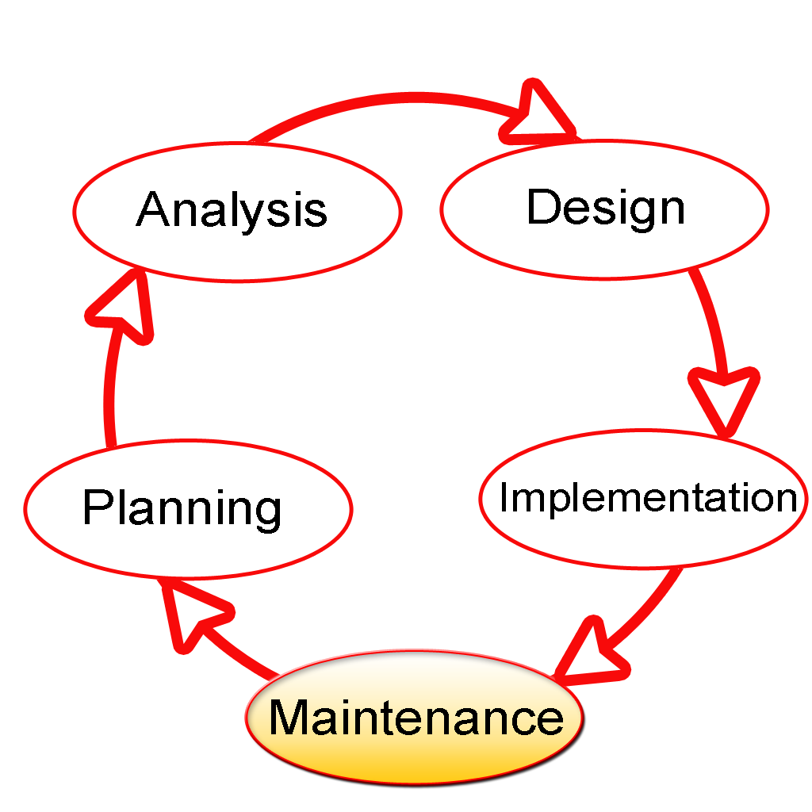
Stage 4
Stage 5
Implementation stage
Maintenance stage
Most times in project as a business analysis it is during this stage that I might need to play a critical role in helping facilitate this rhythm as the Scrum Master. I would need to build understanding of the creation of content strategy, including input required, gathering of input, definition of overall vision, solution identification, governance issues, and structure of the final strategy. Test criteria are provided for the testers, these criteria help to ensure that the coded solution traces back successfully to all the original requirements. Conflict resolution is highly needed during this period.
At this stage I am expected to present the project to the client and gain acceptance, create user-training manuals, capture fixes for future versions of s/w solution, create final product documentations, document project lessons learned

Slide 9
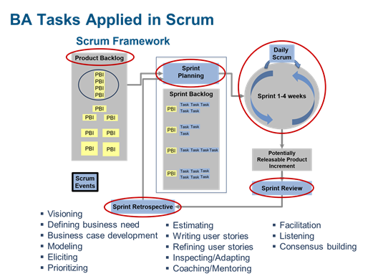
Pictorial View of Task
2
+

Slide 10
THANK YOU
2
+
2
+

